Slide 1
DATING SYSTEM
MINI PROJECT REVIEW
Rohit Karalkar 31
Rohan Mane 40
Pushkar Mavale 41
Himanshu Mishra 43

Slide 2
PROBLEM STATEMENT :
Dating System: In this project we facilitate our registrants the search for potential equivalents for themselves in an easy and secure way .
The recommendations will be based on location, Age, hobbies and other various aspects of user’s. They will be provided with a personality quiz to help the other user to know them better .

Slide 3
NEED AND OBJECTIVE OF PROJECT :
Recently Japan appointed Tet sushi Sakamoto as its first ever Minister of loneliness to tackle the rise in suicide rates in Japan.
Not only Japan, Britain has also already created an isolation/loneliness countermeasures office.
Today in this fast moving world people need someone to share their sorrow’s and happiness.
This project will help the individuals who are alone and need someone to be with them.

Slide 4
PROJECT FLOW DIAGRAM :
Register
Home
My Profile
Login
Confirm request’s
View Request/Matches

Slide 5
Usage Of Technologies :
Python’s Tkinter and MySQL .
Innovativeness in solution :
Here we have kept a personality quiz which will help the individuals to know each other better .
User also gets an opportunity to ask their own question and get the answer’s of it from the individuals interested to send them request .

Slide 6
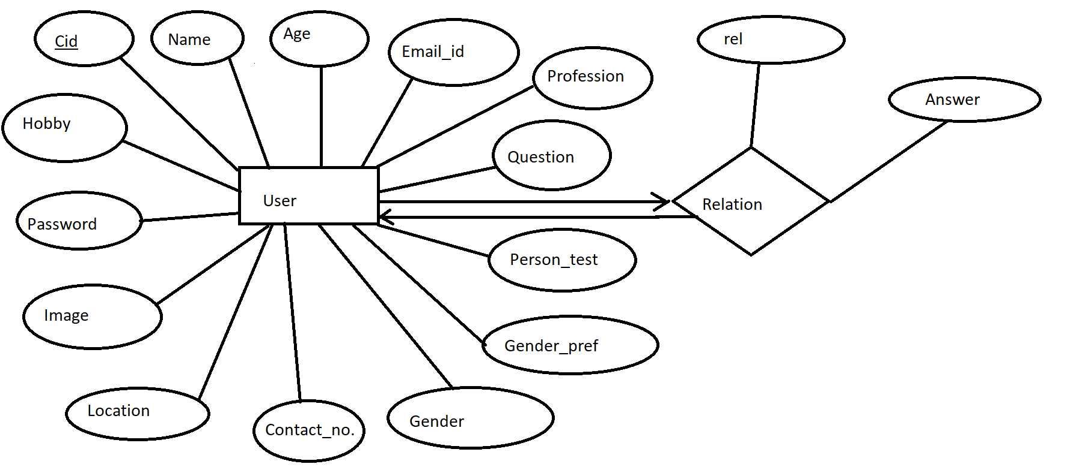
ER Diagram of DATING SYSTEM :
M
N

Slide 7
Relational Schema of Dating System :
Cid | Name | Age | Image | Question | Person Test | Hobby | Profession | Gender | Location | Email ID | Number | Gender Pre | Password
Cidr | Cida | rel | Answer

Slide 8
Back End Section
This is the Back End section of our Dating System.
It consists of primarily the source from which data will be fetched. Its just an example how primarily it will get filled.

Slide 9
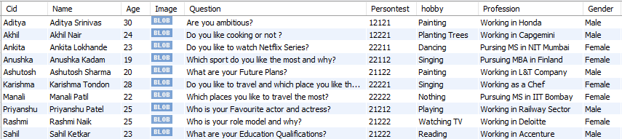
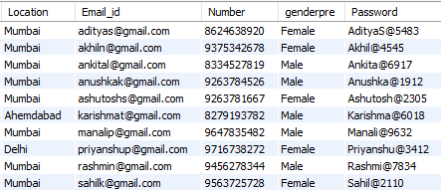

Slide 10
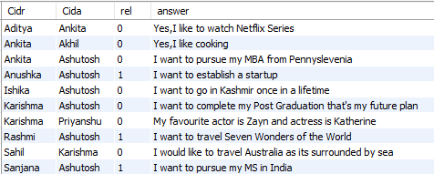

Slide 11
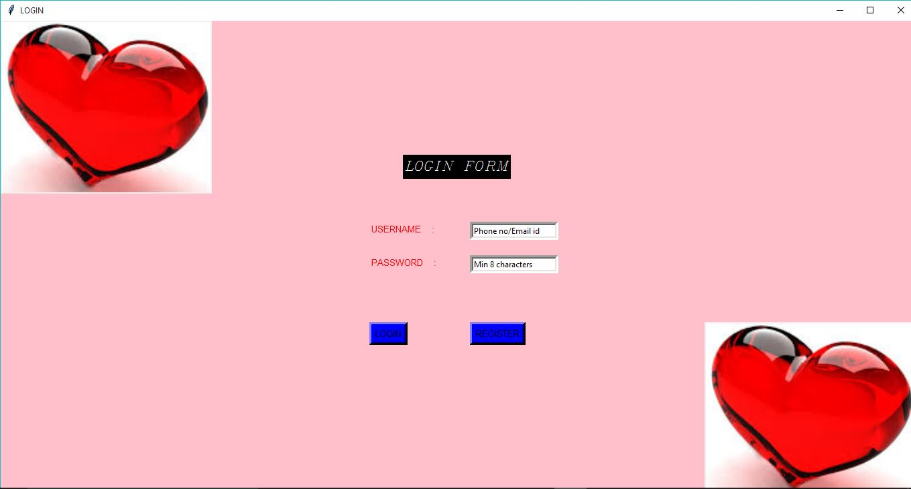
LOGIN PAGE
This is the first interface of this project . From here user gets an opportunity to register . If they are already registered they can directly login by providing their credentials .

Slide 12
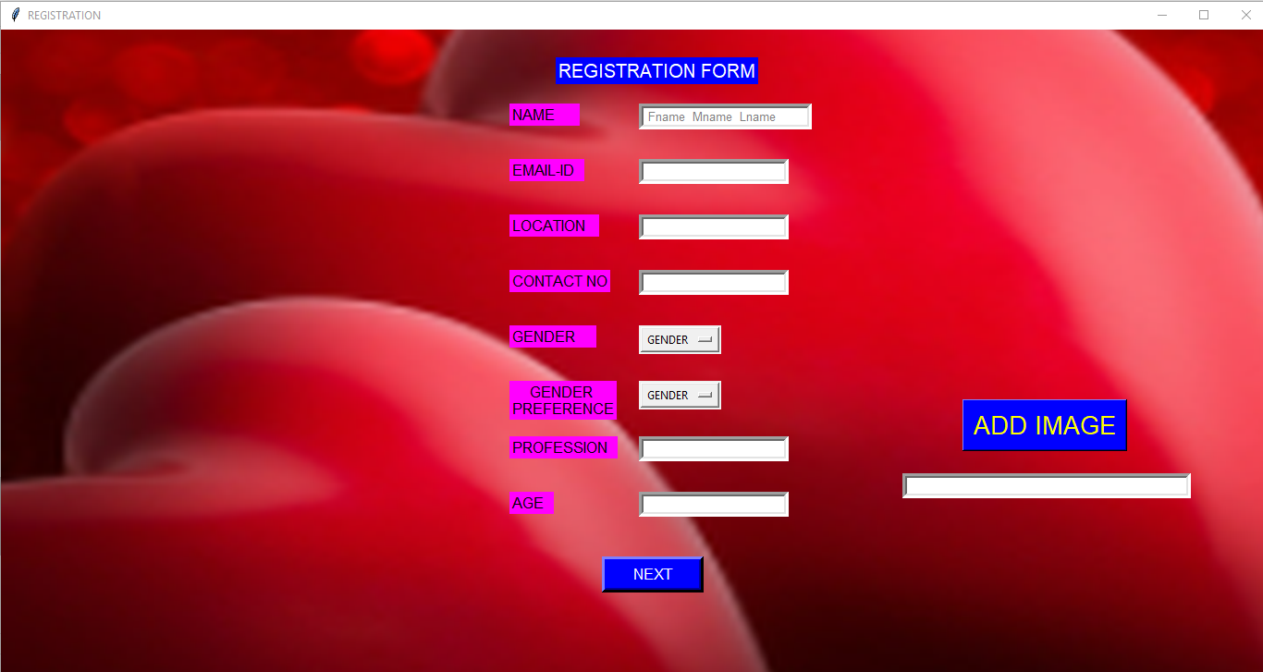
REGISTRATION PAGE
If user clicks on register he/ she is directed to this page .

Slide 13
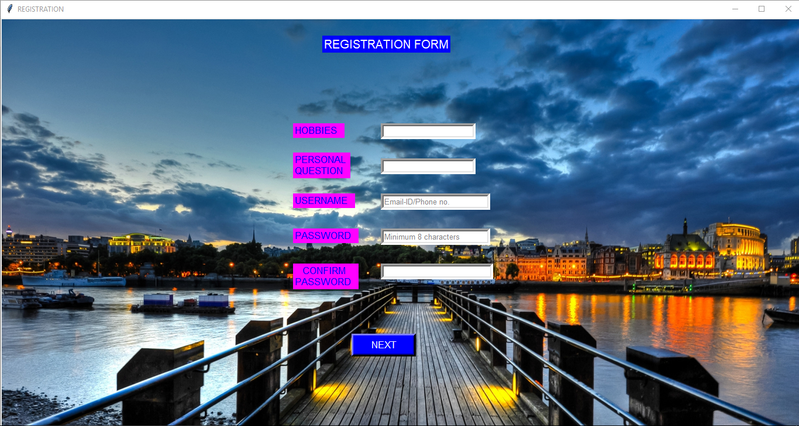
Second Page Of Registration :

Slide 14
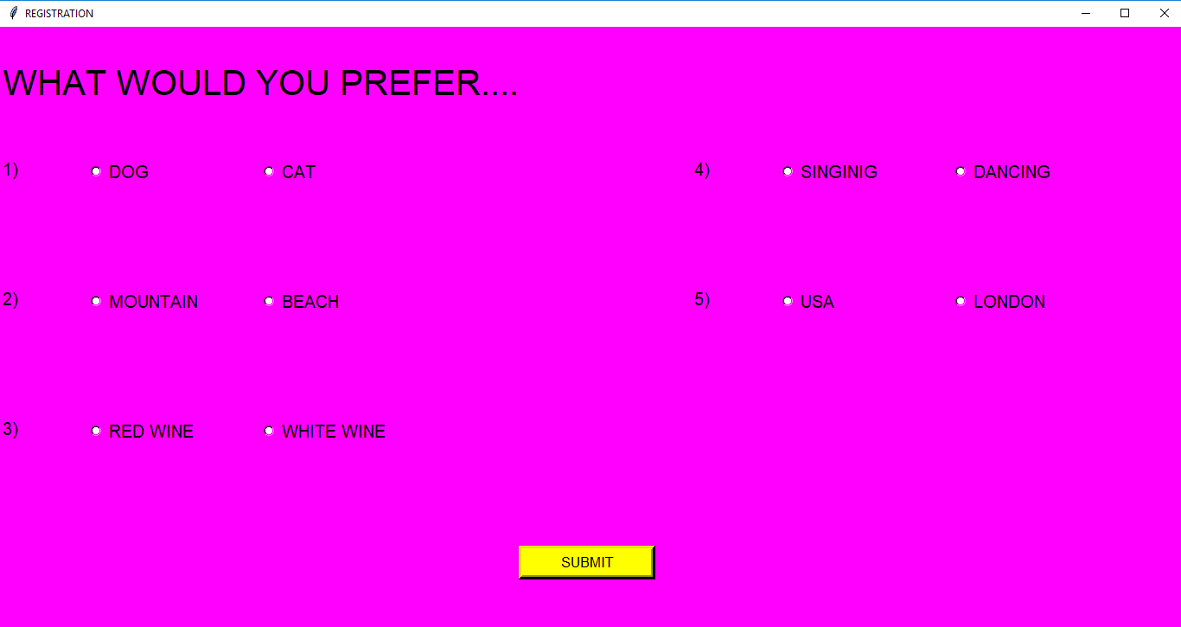
Third Page Of Registration :

Slide 15
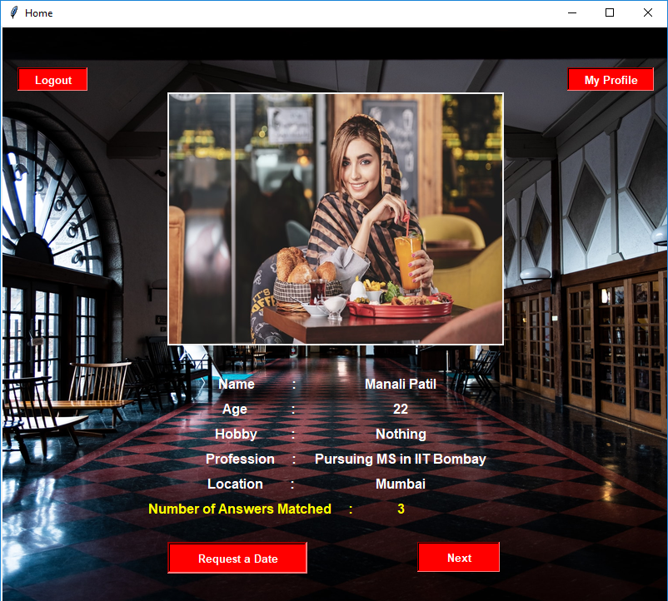
HOME PAGE

Slide 16
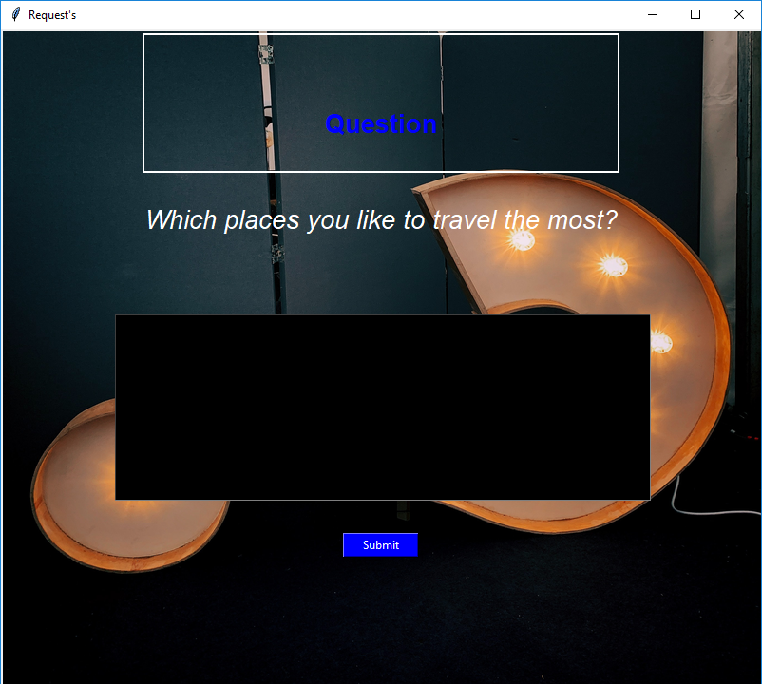
When the user selects Request A Date on Home Page , he encounters a page with the question asked by the Other person .

Slide 17
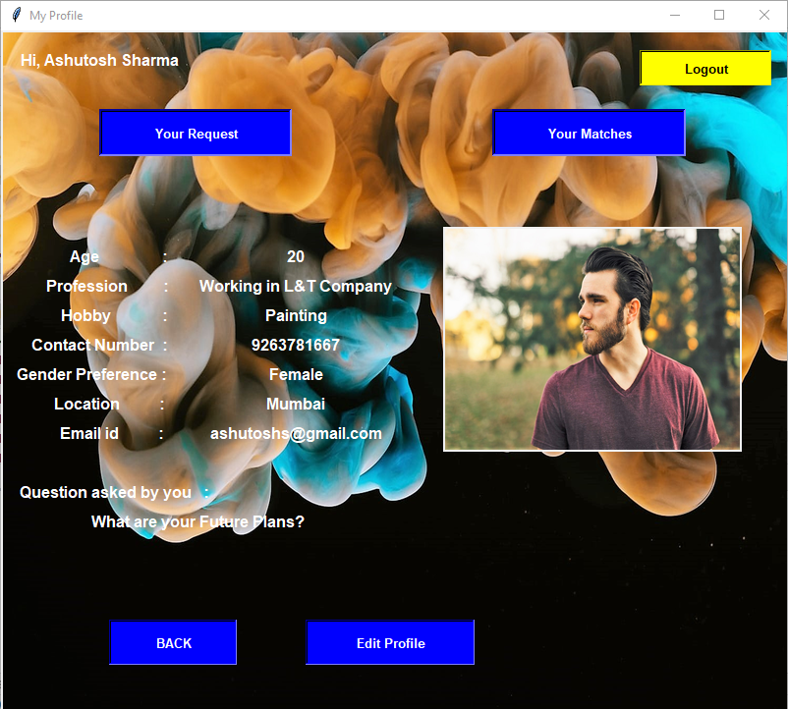
MY PROFILE PAGE
.

Slide 18
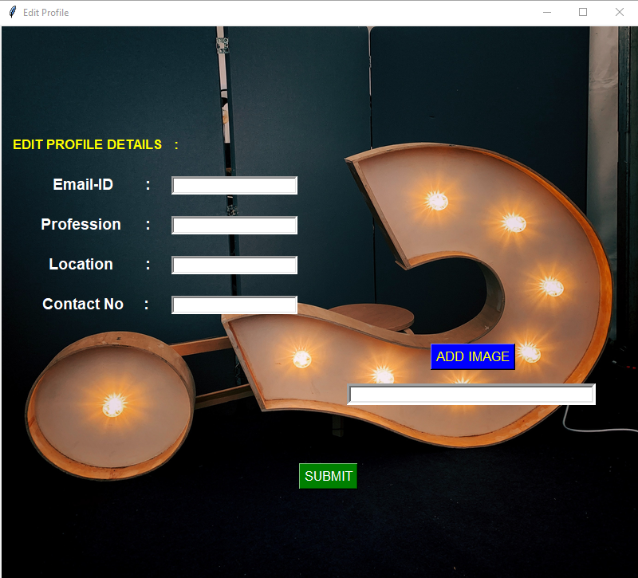
EDIT PROFILE PAGE

Slide 19
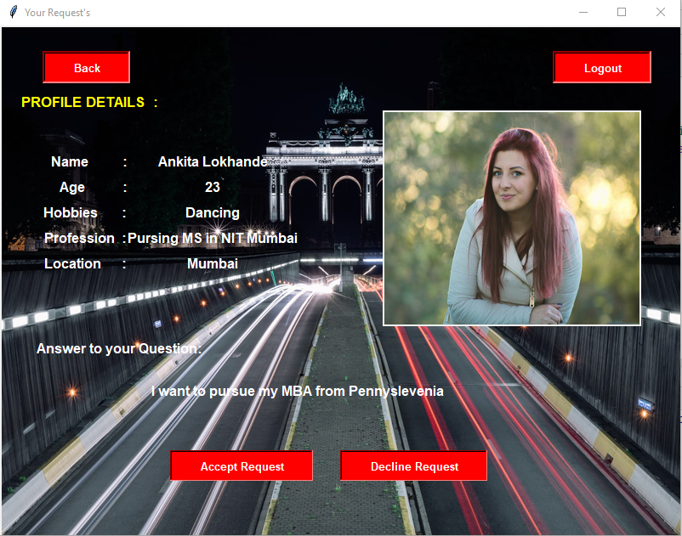
If user clicks on Your Request’s button then they are directed to this page here they get opportunity to either Accept or Decline the request after which they are directed towards other request’s(if there are any).

Slide 20
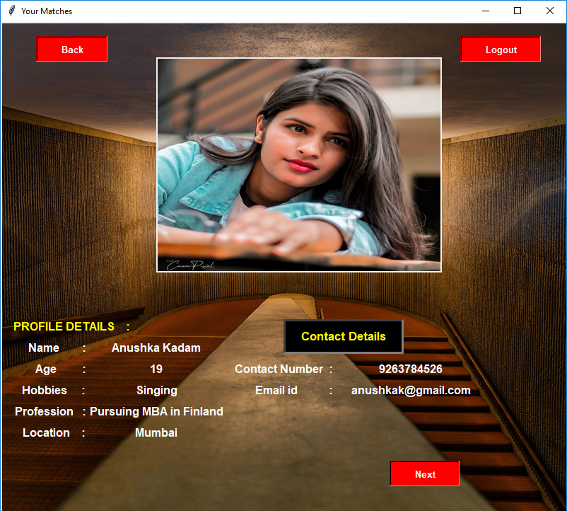
Now, if user clicks on Your Matches they are directed to this page here they get the contact detail’s of the matched user.

Slide 21

THANK YOU !!

